Slide 1
Cloud Networking
Using AWS

Slide 2
Welcome!
Agenda:
Express AWS Primer
Morning Tea 10:15am-10:30am
Express Networking Primer
Lunch 12pm-12:45pm
Setting up our Cloud Network
Afternoon Tea 2pm-2.15pm
Network Testing
Whiteboarding
Wrap-Up by 4pm

Slide 3

Who are we?
Image sourced from: https://broadlygenderphotos.vice.com/

Slide 4



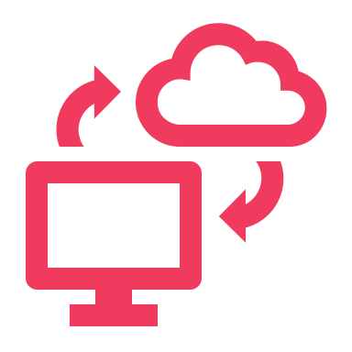


Two Modes of Learning
Theory
We’ll introduce you to some concepts and answer questions
Hands On
We’ll jump into the AWS console and start creating our cloud networks

Slide 5


Slide 6
The what and why of AWS
What is AWS?
Why do we use AWS?
Over 200+ services to enable cloud based infrastructure that you can manage
One of many providers of cloud infra such as MS Azure, Google, IBM, and more
Data storage, compute power, networking, web hosting, etc
Enables scalable microservices in a highly secure environment
Reliable, flexible, and available
Unparalleled service offerings (150+ more than Google)
Best in class support, redundancy, and availability

Slide 7
History: What came before AWS?
Then:
Now:
Long lived, dedicated servers
Long lead times for new contracted infra
Estimated infra, often over-provisioned
Fixed hardware, low scalability
Short lived, shared services
Cost shared by consumers
Infra on demand
Virtual hardware, highly scalable

Slide 8


Slide 9
AWS 101: Cloud Compute
EC2 - Elastic Compute Cloud
Lambda - Serverless Compute
DynamoDB - Key:Value Data store
SNS - Simple Notification Service
SQS - Simple Queue Service
S3 - Simple Storage Service
Athena – Serverless Query Language
Cloudformation - Infra as code

Slide 10
AWS 101: WHAT THE WHAT!?
EC2
Lambda
SQS
S3
DynamoDB
Athena
SNS
Cloudformation
A function that is triggered by events.
A subscriber notification system
A queue of messages
A cloud stack constructor
A computer in the cloud
A bucket for files
A way to query file contents
A simple data table

Slide 11
AWS 101: WHAT THE WHAT!?
EC2
Lambda
SQS
S3
DynamoDB
Athena
SNS
Cloudformation
Used for fast, repeated, scalable operations;
Commonly used with SQS, to notify subscribers of new messages
Funnels data/messages; decouples microservices
Turns YAML into AWS services/resources
Used for many purposes; hosting sites, compute ops, CI/CD, etc
File storage; globally available per account
SQL for S3; Pay per query
Simple data table; <10ms performance

Slide 12


Slide 13
Morning Tea!
See you in 15 mins

Slide 14

Networking 101
Digital Copy:
Jvns.ca/networking-zine.pdf
Created by Julia Evans
@b0rk
Notes:
Zine talk about Ips, CIDR ranges, SSL, ports, subnets

Slide 15
REFRESHER: Networking OSI Model (Open Systems Interconnection)
7 Application Layer
For human consumption – what we see 👀 eg. HTTP, SNMP, FTP
6 Presentation Layer
Processes data to be used by the app layer, including encryption/decryption, jpg, SSL, TLS
5 Session Layer
4 Transportation Layer (TCP/UDP)
Responsible for transporting packets in a way that covers flow control and reliability
3 Network Layer
Routing data from A to B going across boundaries – IP’s, ICMP, IPsec, IGMP
2 Data Link Layer
How data is linked up from point A to B eg. ARP, MAC Address
1 Physical Layer
Hardware responsible for data transmission – eg the physical cables, hubs, wireless
Creation/Tear down of network connections

Slide 16
Intro to AWS Networking Resources
Virtual Private Cloud (VPC)
CIDR Range
Subnets
Internet Gateway (IGW)
NAT Gateway
Direct Connect/VPN
VPC Peering
Route Table
Security Groups
Load Balancer
Systems Manager Agent (SSM Agent)
Defines where network traffic can go
Isolated part of the cloud of your AWS services
Connecting VPCs
Connects your VPC to the internet
A managed AWS service that distributes traffic to targets you specify
Securely connect a private subnet to a public subnet
A subset of your VPC
Securely connect your VPC to on-prem infrastructure
Set of rules to block/allow inbound/outbound network traffic
Determines number of IPs your VPC can have
An agent to run a Systems Manager to update, manage, and configure an EC2

Slide 17
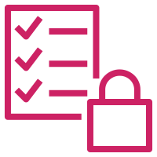


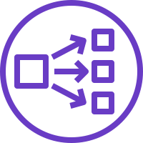
What you will create today
VPC + Subnets
Internet Gateway
Private + Public Route Table
NAT Instance
Security Group
Public Load Balancer
Private Servers
VPC
Private Subnet
Public Subnet
Security Group
Load Balancer
Internet
Web Servers
Public Route Table
NAT
Private Route Table

Slide 18
IPs and CIDR Ranges
IPs
It’s an identifying address for a routable resource.
CIDR
“Classless Inter-Domain Routing is a method for allocating IP addresses and IP routing.”
A CIDR is a range of IP’s allocated to a part of your network.

Slide 19
IP’s in more detail…
Basics
An IP address is composed of two parts:
IP addresses contain 4 octets, each consisting of 8 bits giving values between 0 and 255 🤯
The ‘netmask’ designates how many available addresses are in the block – this is number after the /x
The smaller the netmask, the more IP’s that are available
The Network ID: The Network ID represents the first groups of digits from the IP address. It marks the network the devices are connected to. For example, the IP 193.164.2.35, the network ID is 193.164.2.
The Host ID: The last group of digits from the IP address labels the specific device. In this example 193.164.2.35, the host ID would be 35.

Slide 20
IP’s in your Cloud Network
10.0.0.0/16
VPC
Private Subnet
Public Subnet
Security Group
10.0.1.X
10.0.2.X
Load Balancer
Internet
Web Servers
Public IP
Public Route Table
NAT
Private Route Table
10.0.1.0/24
10.0.2.0/24
Known to the internet

Slide 21
AWS and IP’s
/x is the size of the bytes
VPCs - between /16 and /8
Subnets - between /16 and /28 (CIDR blocks of the subnets cannot overlap)
Subnet CIDR range cannot be the same or larger than the VPC

